Slide 1
Accelerometer Parameters

Slide 2
Effective Mass Verification
Consider a beam of the following parameters:
  Dimensions: 5 mm x 5 mm x 20 mm
  Material: Silicon
  Density: 2320 kg
Parameter | Analytical | COMSOL | Percentage Error
Mass | 1.16e-3 kg | 1.16e-3 kg | 0 %
Effective Mass | 2.7342 e-4 kg | 2.7355 e-4 kg | 0.004%

Slide 3
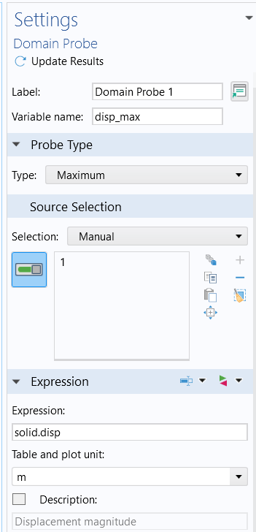
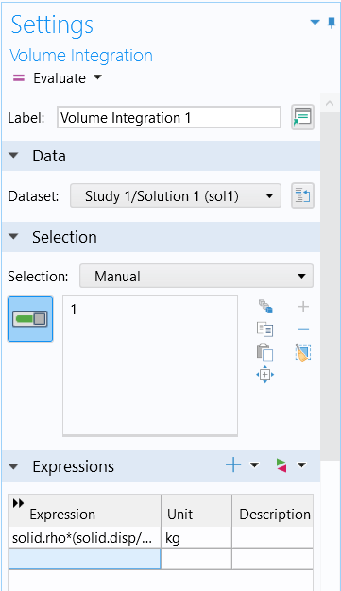
How the results are extracted from COMSOL
Step 1: Define a domain probe with the following settings.
Step 2: After running the simulation:
      Results> Derived Values> Integration> Volume Integration
      In the Formula Section Input the following formula: solid.rho*(solid.disp/disp_max)^2

Slide 4
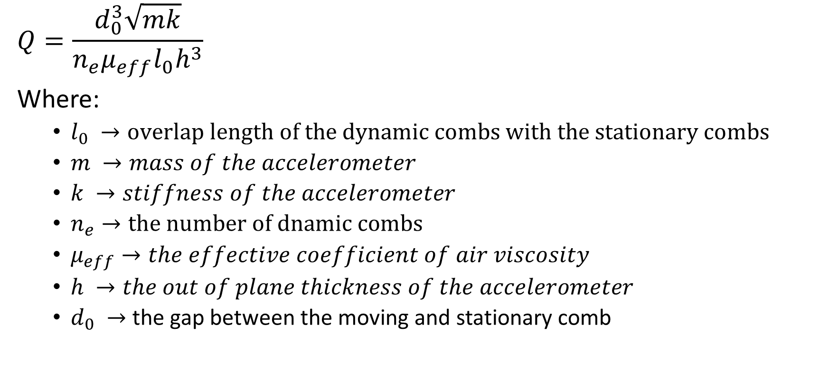
Quality Factor
$$Q=\frac{d_{0}^{3}\sqrt{mk}}{n_{e}μ_{eff}l_{0}h^{3}}$$
Where:
  $l_{0} →overlap length of the dynamic combs with the stationary combs$
  $m →mass of the accelerometer$
  $k →stiffness of the accelerometer$
  $n_{e}→the number of dnamic combs$
  $μ_{eff}→the effective coefficient of air viscosity$
  $h →the out of plane thickness of the accelerometer$
  $d_{0} →$ the gap between the moving and stationary comb

Slide 5
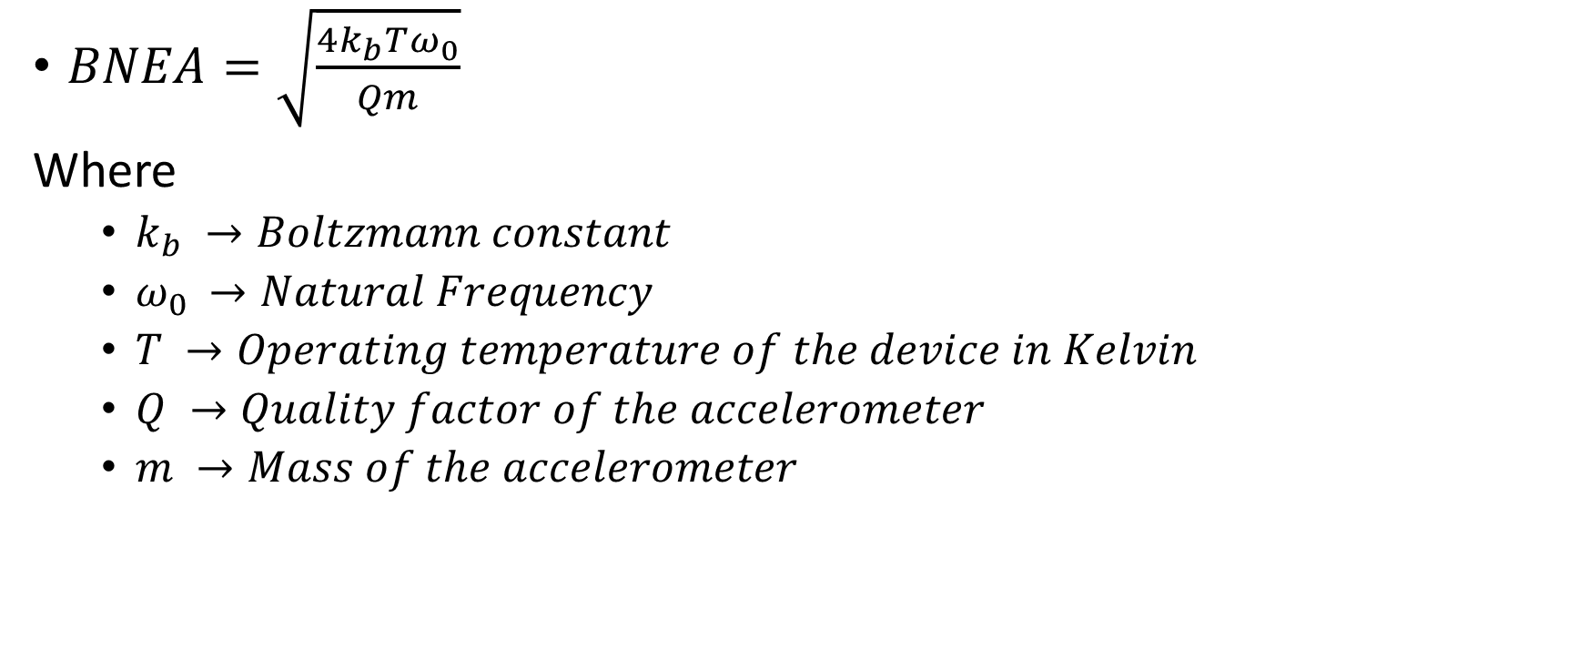
Brownian Noise Equivalent Acceleration
$BNEA=\sqrt{\frac{4k_{b}Tω_{0}}{Qm}}$
Where
  $k_{b} →Boltzmann constant$
  $ω_{0 }→Natural Frequency$
  $T →Operating temperature of the device in Kelvin$
  $Q →Quality factor of the accelerometer$
  $m →Mass of the accelerometer$

